Slide 1
Application Security
Corporate Computer Security, 4th Edition
Randall J. Boyle & Raymond R. Panko
Chapter 8

Slide 2
Learning Objectives
Explain why attackers increasingly focus on applications.
List the main steps in securing applications.
Know how to secure WWW services and e-commerce services.
Describe vulnerabilities in web browsers.
Explain the process of securing e-mail.
Explain how to secure voice over IP (VoIP).
Describe threats from Skype VoIP service.
Describe how to secure other user applications.
Know how to secure TCP/IP supervisory applications.

Slide 3
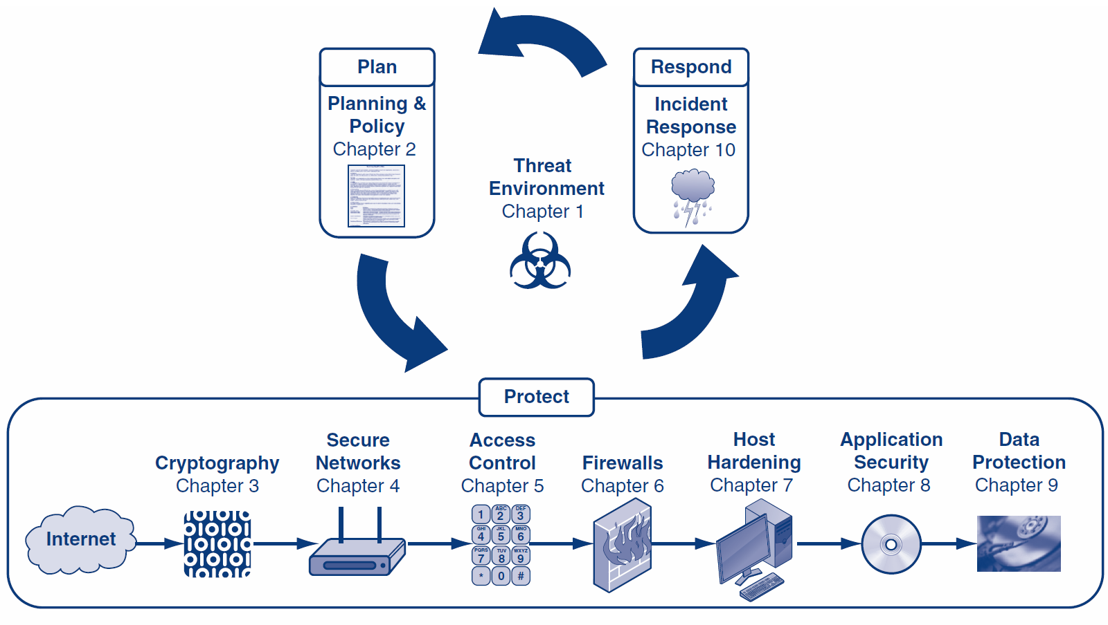

Slide 4
Orientation
Some attacks inevitably get through network protections and reach individual hosts
In Chapter 7, we looked at host hardening
In Chapter 8, we look at application hardening
In Chapter 9, we will look at data protection

Slide 5
What’s Next?
8.1 Application Security and Hardening
8.2 WWW and E-Commerce Security
8.3 Web Browser Attacks
8.4 E-Mail Security
8.5 Voice over IP (VoIP) Security
8.6 Other User Applications

Slide 6
8.1: Application Security Threats
Executing Commands with the Privileges of a Compromised Application
If an attacker takes over an application, the attacker can execute commands with the privileges of that application
Many applications run with super user (root) privileges

Slide 7
8.1: Application Security Threats
Buffer Overflow Attacks
Vulnerabilities, exploits, fixes (e.g., patches, manual work-arounds or upgrades) (Chapter 7)
Buffers are places where data is stored temporarily
If an attacker sends too much data, a buffer might overflow, overwriting an adjacent section of RAM

Slide 8
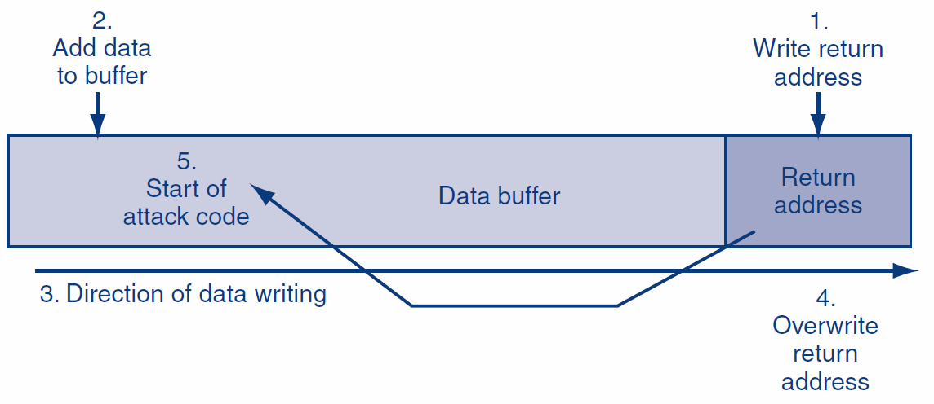
8.1: Stack Entry and Buffer Overflow

Slide 9
8.1: Application Security Threats
Few Operating Systems but Many Applications
Application hardening is more total work than operating system hardening
Understanding the Server’s Role and Threat Environment
If it runs only one or a few services, easy to disallow irrelevant things

Slide 10
8.1: Hardening Applications
Basics
Physical Security
Backup
Harden the Operating System
Etc.
Minimize Applications
Main applications
Subsidiary applications
Guided by security baselines

Slide 11
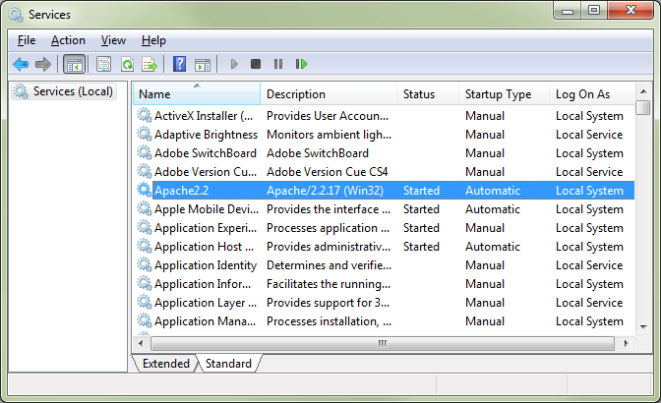
8.1: Windows Services

Slide 12
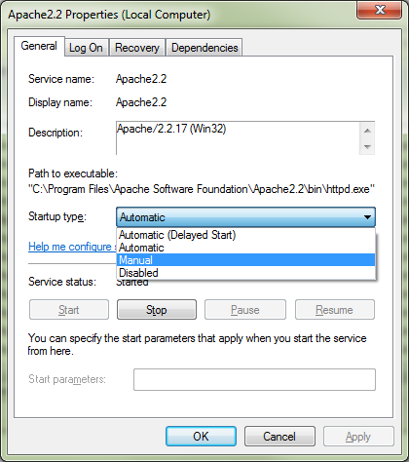
8.1: Application Startup Options

Slide 13
8.1: Hardening Applications
Create Secure Application Program Configurations
Use baselines to go beyond default installation configurations for high-value targets
Avoid blank passwords or well-known default passwords
Install Patches for All Applications
Minimize the Permissions of Applications
If an attack compromises an application with low permissions, it will not own the computer

Slide 14
8.1: Hardening Applications
Add Application Layer Authentication, Authorizations, and Auditing
More specific to the needs of the application than general operating system logins
Can lead to different permissions for different users
Implement Cryptographic Systems
For communication with users

Slide 15
8.1: Securing Custom Applications
Custom Applications
Written by a firm’s programmers
Not likely to be well-trained in secure coding
The Key Principle
Never trust user input
Filter user input for inappropriate content

Slide 16
8.1: Securing Custom Applications
Buffer Overflow Attacks
In some languages, specific actions are needed
In other languages, not a major problem
Login Screen Bypass Attacks
Website user gets to a login screen
Instead of logging in, enters a URL for a page that should only be accessible to authorized users

Slide 17
8.1: Securing Custom Applications
Cross-Site Scripting (XSS) Attacks
One user’s input can go to another user’s webpage
Usually caused if a website sends back information sent to it without checking for data type, scripts, etc.
Example: If you type your username, it may include something like “Hello username” in the webpage it sends you

Slide 18
8.1: Securing Custom Applications
Example
Attacker sends the intended victim an e-mail message with a link to a legitimate website
However, the link includes a script that is not visible in the browser window because it is beyond the end of the window
The intended victim clicks on the link and is taken to the legitimate webpage
The URL’s script is sent to the webserver with the HTTP GET command to retrieve the legitimate webpage

Slide 19
8.1: Securing Custom Applications
Example
The webserver sends back a webpage including the script
The script is invisible to the user (browsers do not display scripts)
The script executes
The script may exploit a vulnerability in the browser or another part of the user’s software

Slide 20
8.1: Securing Custom Applications
SQL Injection Attacks
For database access
Programmer expects an input value—a text string, number, etc.
May use it as part of an SQL query or operation against the database
May accept a last name as input and return the person’s telephone number

Slide 21
8.1: Securing Custom Applications
SQL Injection Attacks
Attacker enters an unexpected string
Example: A last name followed by a full SQL query string
The program may execute both the telephone number lookup command and the extra SQL query
This may look up information that should not be available to the attacker
It may even delete an entire table

Slide 22
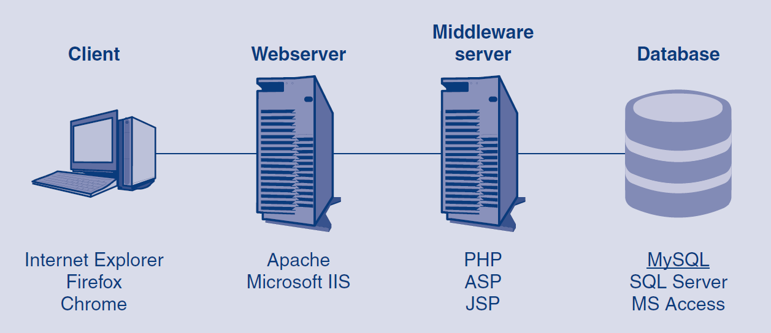
8.1: SQL Injection Path

Slide 23
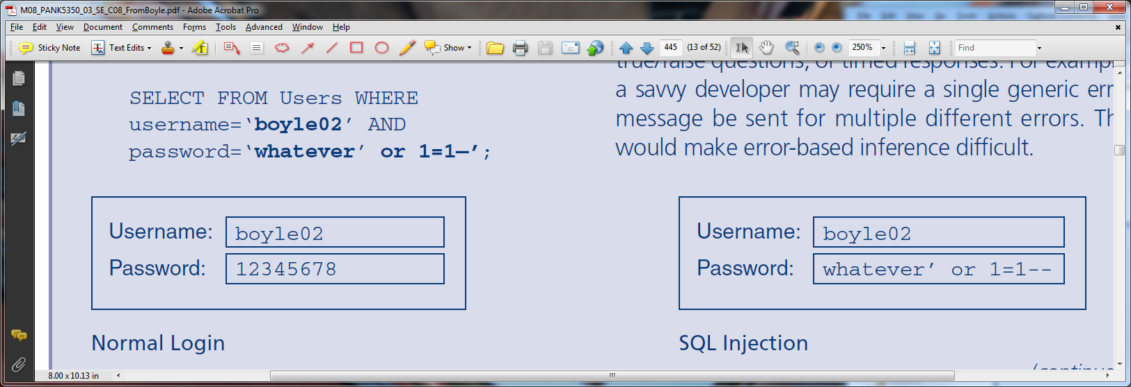
8.1: SQL Injection

Slide 24
8.1: Securing Custom Applications
Must Require Strong Secure Programming Training
General principles
Programming-language-specific information
Application-specific threats and countermeasures

Slide 25
What’s Next?
8.1 Application Security and Hardening
8.2 WWW and E-Commerce Security
8.3 Web Browser Attacks
8.4 E-Mail Security
8.5 Voice over IP (VoIP) Security
8.6 Other User Applications

Slide 26
8.2: WWW and E-Commerce
Importance of WWW Service and E-Commerce Security
Cost of disruptions, harm to reputation, and market capitalization
Customer fraud
Exposure of sensitive private information

Slide 27
8.2: WWW and E-Commerce
Webservice versus E-Commerce Service
WWW service provides basic user interactions
Microsoft Internet Information Server (IIS), Apache on UNIX, other webserver programs
E-commerce servers add functionality—order entry, shopping cart, payment, etc.
Links to internal corporate databases and external services, such as credit card checking
Custom programs written for special purposes

Slide 28
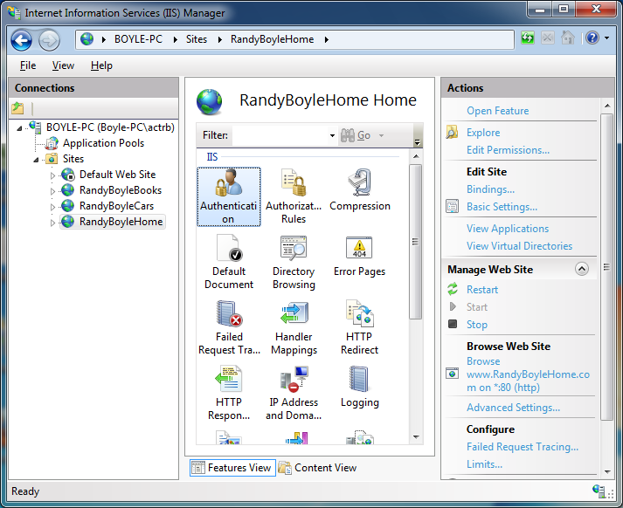
8.2: Internet Information Services (IIS)

Slide 29
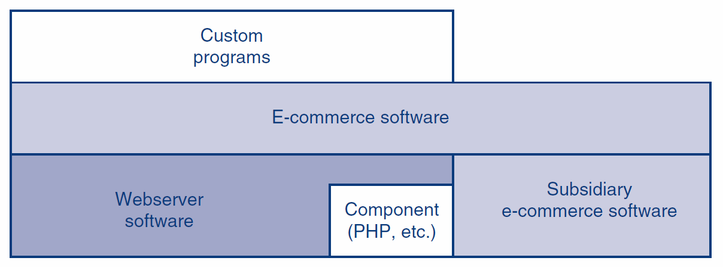
8.2: WWW Service vs. E-Commerce Service

Slide 30
8.2: Webserver Attacks
Website Defacement
Numerous IIS buffer overflow attacks
Many of which take over the computer
IIS directory traversal attacks

Slide 31
8.2: Directory Traversal Attack
Users should only be able to reach files below the WWW root, which is below the true system root.

Slide 32
8.2: Directory Traversal Attack
In URLs, .. means
move up one level.
If allowed, user can
get outside the WWW root box, into other directories.

Slide 33
8.2: Webserver Attacks
IIS directory traversal attacks (Figure 8-11)
Companies filter out “..”
Attackers respond with hexadecimal and UNICODE representations for “..” and “..”
Typical of the constant “arms race” between attackers and defenders

Slide 34
8.2: Webserver and E-Commerce Protections
Patching the WWW and E-Commerce Software and Their Components
Patching the webserver software is not enough
Must also patch e-commerce software
E-commerce software might use third-party component software that must be patched

Slide 35
8.2: Webserver and E-Commerce Protections
Other Website Protections
Website vulnerability assessment tools, such as Whisker
Reading website error logs
Placing a webserver-specific application proxy server in front of the webserver

Slide 36
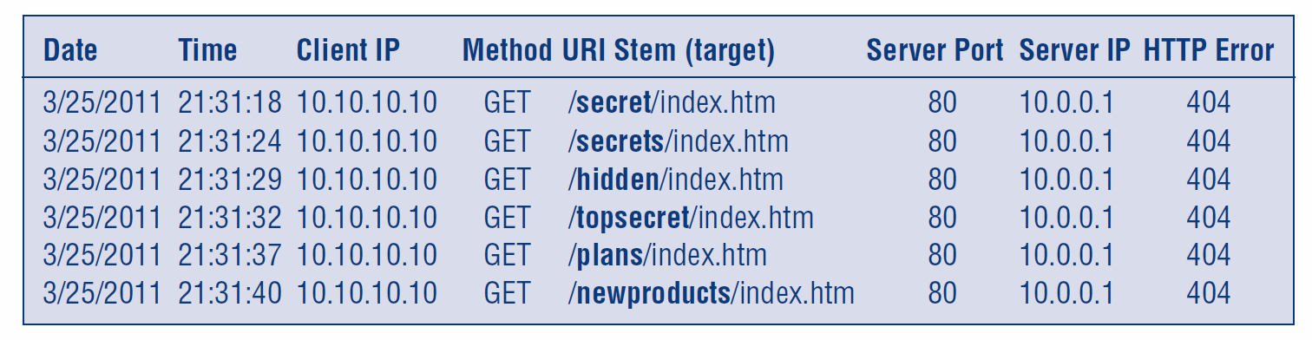
8.2: Webserver Error Logs
An internal employee (10.10.10.10) may be blindly searching for confidential directories (bolded) on an internal webserver (10.0.0.1).

Slide 37
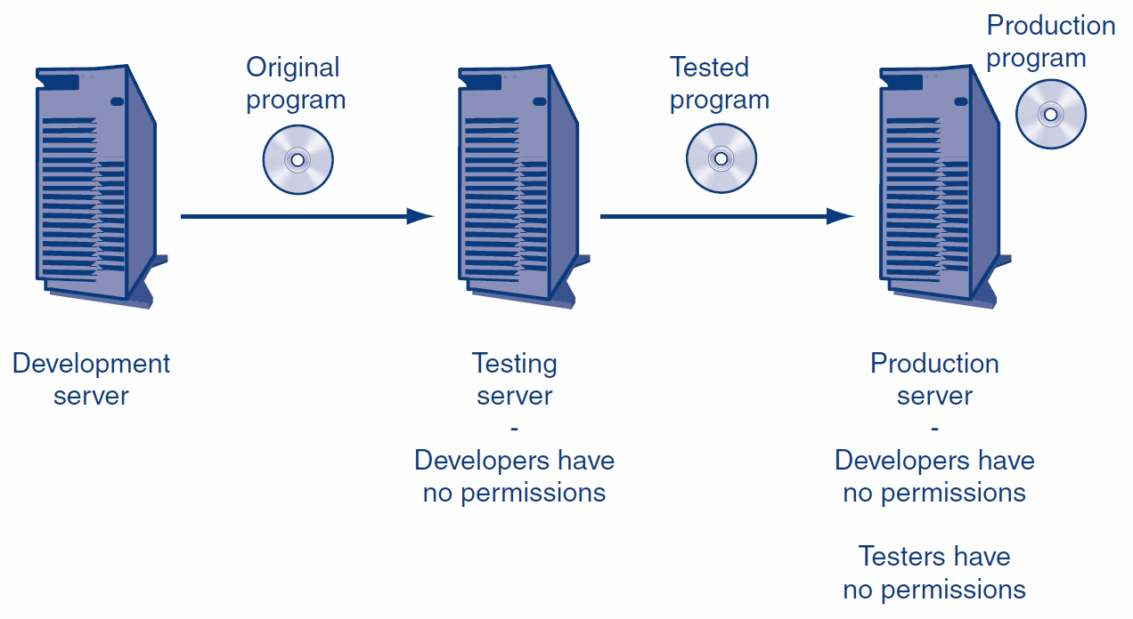
8.2: Staging Servers

Slide 38
What’s Next?
8.1 Application Security and Hardening
8.2 WWW and E-Commerce Security
8.3 Web Browser Attacks
8.4 E-Mail Security
8.5 Voice over IP (VoIP) Security
8.6 Other User Applications

Slide 39
8.3: Browser Attacks and Protections
PCs Are Major Targets
Have interesting information and can be attacked through the browser
Client-Side Scripting (Mobile Code)
Java applets: small Java programs
Usually run in a “sandbox” that limits their access to most of the system
Active-X from Microsoft; highly dangerous because it can do almost everything

Slide 40
8.3: Browser Attacks and Protections
Client-Side Scripting (Mobile Code)
Scripting languages (not full programming languages)
A script is a series of commands in a scripting language
JavaScript (not scripted form of Java)
VBScript (Visual Basic scripting from Microsoft)
A script usually is invisible to users

Slide 41
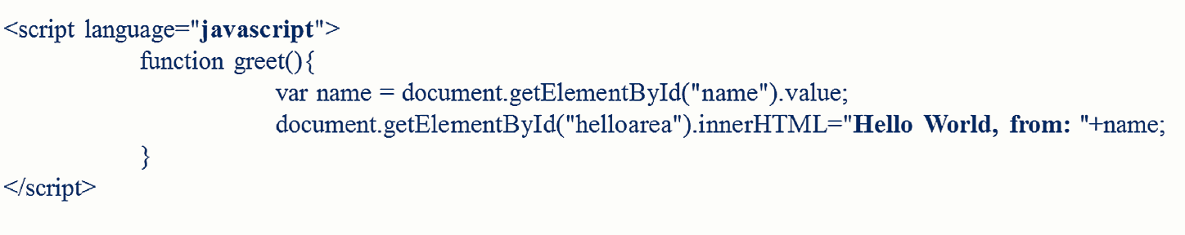
8.3: Javascript (sample)

Slide 42
8.3: Browser Attacks and Protections
You like beef?
Click here.
Malicious Links
User usually must click on them to execute (but not always)
Tricking users to visit attacker websites
Social engineering to persuade the victim to click on a link
Uses domain names that are common misspellings of popular domain names
http://www.micosoft.com

Slide 43
8.3: Browser Attacks and Protections
Other Client-Side Attacks
File reading: turns the computer into an unintended file server
Executing a single command
The single command may open a command shell on the user’s computer
The attacker can now enter many commands
C:>

Slide 44
8.3: Browser Attacks and Protections
Other Client-Side Attacks
Automatic redirection to unwanted webpage
On compromised systems, the user may be automatically directed to a specific malicious website if they later make any typing error

Slide 45
8.3: Browser Attacks and Protections
Other Client-Side Attacks
Cookies
Cookies are placed on user computer; can be retrieved by website
Can be used to track users at a website
Can contain private information
Accepting cookies is necessary to use many websites

Slide 46
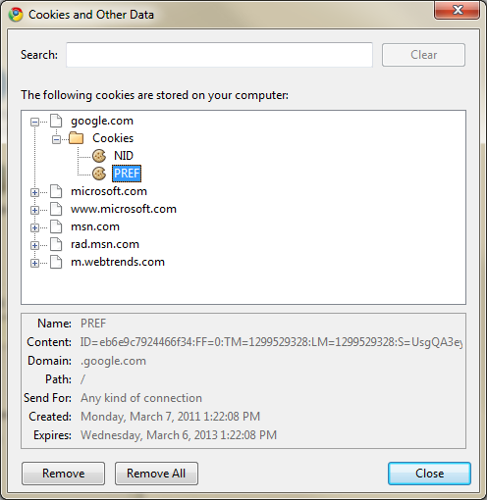
8.3: A Google.com Cookie

Slide 47
8.3: Browser Attacks and Protections
Enhancing Browser Security
Patches and updates
Set strong security configuration options for Microsoft Internet Explorer
Set strong privacy configuration options for Microsoft Internet Explorer

Slide 48
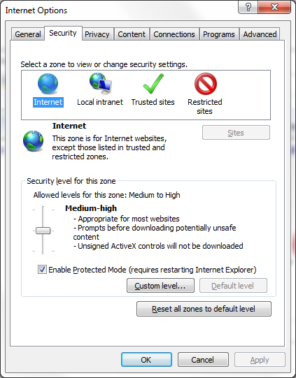
8.3: Internet Options Dialog Box in Internet Explorer

Slide 49
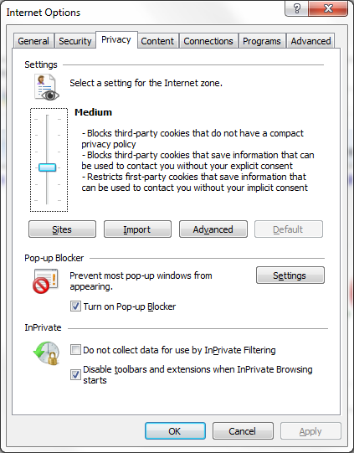
8.3: Internet Explorer Privacy Tab

Slide 50
What’s Next?
8.1 Application Security and Hardening
8.2 WWW and E-Commerce Security
8.3 Web Browser Attacks
8.4 E-Mail Security
8.5 Voice over IP (VoIP) Security
8.6 Other User Applications

Slide 51
8.4: E-Mail Security
Content Filtering
Malicious code in attachments and HTML bodies (scripts)
Spam: unsolicited commercial e-mail
Volume is growing rapidly; slowing PCs and annoying users (pornography and fraud)
Filtering for spam also rejects some legitimate messages

Slide 52
8.4: E-Mail Security
Inappropriate Content
Companies often filter for sexually or racially harassing messages
Could be sued for not doing so
Extrusion Prevention for Intellectual Property (IP)
Stopping the Transmission of Sensitive Personally Identifiable Information (PII)

Slide 53
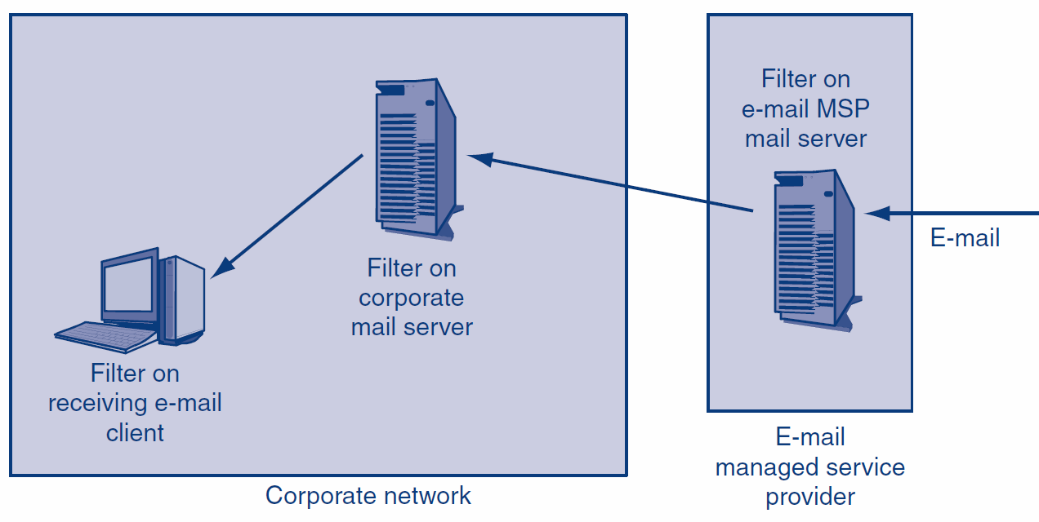
8.4: Possible E-Mail Filtering Locations

Slide 54
8.4: E-Mail Security
Employee training
E-mail is not private; company has right to read
Your messages may be forwarded without permission
Never put anything in a message the sender would not want to see in court, printed in the newspapers, or read by his or her boss
Never forward messages without permission

Slide 55
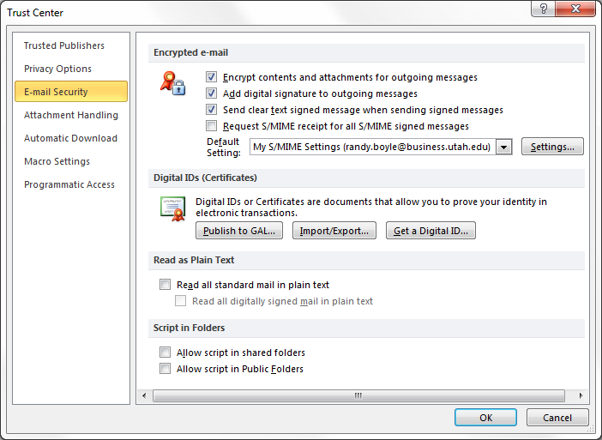
8.4: Microsoft Outlook Email Security Options

Slide 56
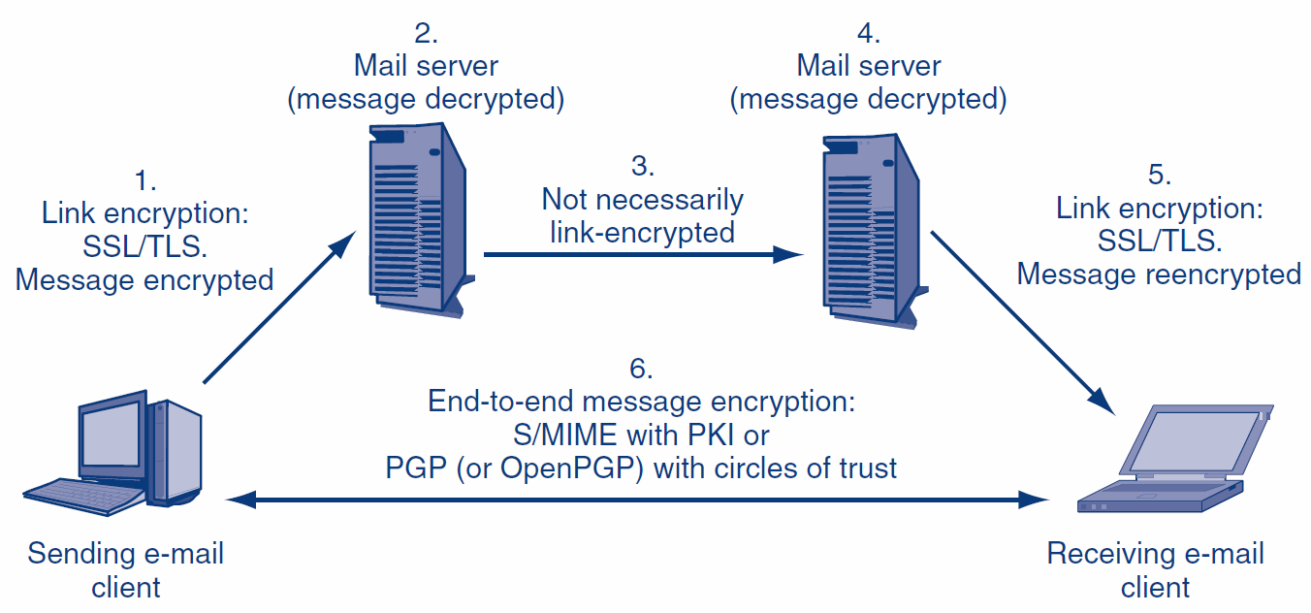
8.4: E-Mail Security (Encryption)

Slide 57
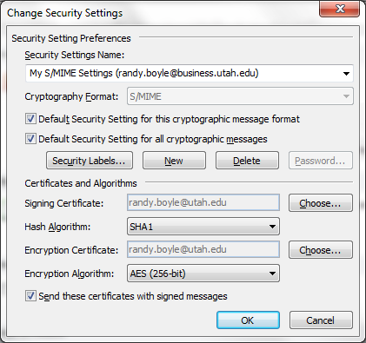
8.4: Microsoft Outlook Hashing and Encryption Options

Slide 58
What’s Next?
8.1 Application Security and Hardening
8.2 WWW and E-Commerce Security
8.3 Web Browser Attacks
8.4 E-Mail Security
8.5 Voice over IP (VoIP) Security
8.6 Other User Applications

Slide 59
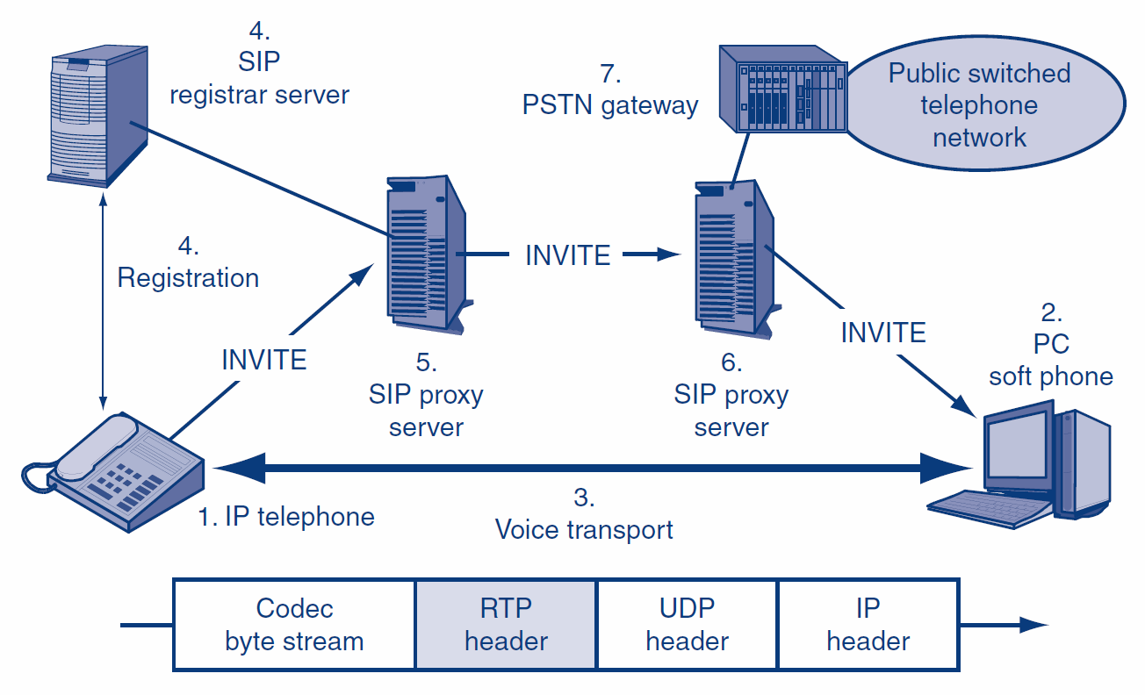
8.5: Voice over IP (VoIP)

Slide 60
8.5: Transport versus Signaling
Concept | Meaning
Transport | The carriage of voice between the two parties
Signaling | Communication to manage the network Call setup Call teardown Accounting Etc.

Slide 61
8.5: VoIP Threats
Eavesdropping
Denial-of-Service Attacks
Even small increases in latency and jitter can be highly disruptive
Caller Impersonation
Useful in social engineering
Attacker can appear to be the president based on a falsified source address

Slide 62
8.5: VoIP Threats
Hacking and Malware Attacks
Compromised clients can send attacks
Compromised servers can send disruptive signaling
Toll Fraud
Attacker uses corporate VoIP network to place free calls
Spam over IP Telephony (SPIT)
Especially disruptive because it interrupts the called party in real time

Slide 63
8.5: Implementing VoIP Security
Basic Corporate Security Must Be Strong
Authentication
SIP Identity (RFC 4474) provides strong authentication assurance between second-level domains
Encryption for Confidentiality
Can add to latency

Slide 64
8.5: Implementing VoIP Security
Firewalls
Many short packets
Firewall must prioritize VoIP traffic
Must handle ports for signaling
SIP uses Port 5060
H.323 uses Ports 1719 and 1720
Must create an exception for each conversation, which is assigned a specific port
Must close the transport port immediately after conversation ends

Slide 65
8.5: Implementing VoIP Security
NAT Problems
NAT firewall must handle VoIP NAT traversal
NAT adds a small amount of latency
Separation: Anticonvergence
The convergence goal for data and voice
Virtual LANs (VLANs)
Separate voice and data traffic on different VLANs
Separate VoIP servers from VoIP phones on different VLANs

Slide 66
8.5: Skype Security Concerns
Widely Used, Public VoIP Service
Uses Proprietary Protocols and Code
Vulnerabilities? Backdoors? Etc.
Firewalls have a difficult time even recognizing Skype traffic
Encryption for Confidentiality
Skype reportedly uses strong security
However, Skype keeps encryption keys, allowing it to do eavesdropping

Slide 67
8.5: Skype Security Concerns
Inadequate Authentication
Uncontrolled user registration; can use someone else’s name and appear to be them
Peer-to-Peer (P2P) Service
Uses this architecture and its proprietary and rapidly changing protocol to get through corporate firewalls
Bad for corporate security control
Skype File Sharing
Does not work with antivirus programs

Slide 68
What’s Next?
8.1 Application Security and Hardening
8.2 WWW and E-Commerce Security
8.3 Web Browser Attacks
8.4 E-Mail Security
8.5 Voice over IP (VoIP) Security
8.6 Other User Applications

Slide 69
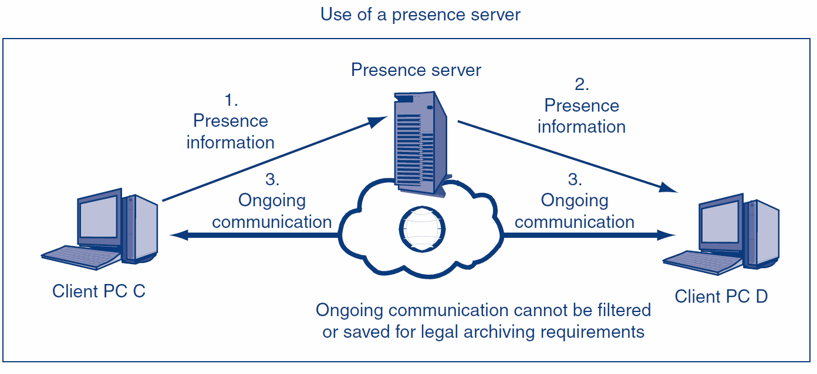
8.6: Servers in Instant Messaging (IM)
Presence servers merely tell the clients that others exist and what their IP addresses are.

Slide 70
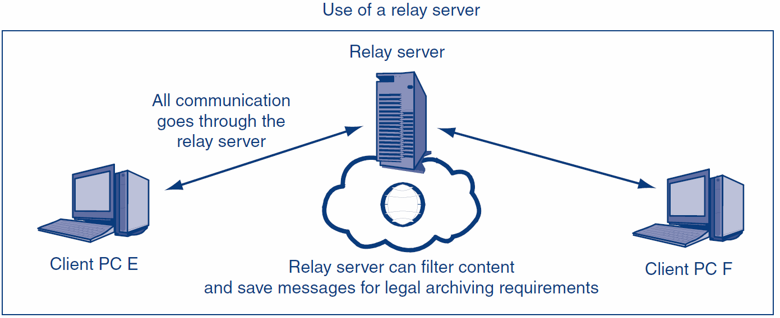
8.6: Servers in Instant Messaging (IM)
All transmissions go through relay servers when relay servers are used.

Slide 71
8.6: TCP/IP Supervisory Applications
TCP/IP Supervisory Protocols
Many supervisory protocols in TCP/IP
ARP, ICMP, DNS, DHCP, LDAP, RIP, OSPF, BGP, SNMP, etc.
The targets of many attacks
The IETF has a program to improve security in all (the Danvers Doctrine)

Slide 72
8.6: TCP/IP Supervisory Applications
Example
Simple Network Management Protocol (SNMP)
Messages
GET messages to get information from a managed object
SET messages to change the configuration of a managed object
SET is often turned off because it is dangerous

Slide 73
8.6: TCP/IP Supervisory Applications
Example
SNMP versions and security
Version 1: No security
Version 2: Weak authentication with a community string shared by the manager and managed devices
Version 3: Pair-shared secrets, optional confidentiality, message integrity, and anti-replay protection
Still needed: public key authentication

Slide 74
8.6: TCP/IP Supervisory Applications
IT Security People Must Work with the Networking Staff
Ensure that appropriate security is being applied to supervisory protocols
Not a traditional area for IT security in most firms

Slide 75
The End

Slide 76
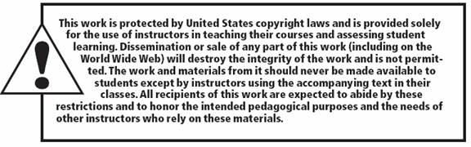
All rights reserved. No part of this publication may be reproduced, stored in a retrieval system, or transmitted, in any form or by any means, electronic, mechanical, photocopying, recording, or otherwise, without the prior written permission of the publisher. Printed in the United States of America.
Copyright © 2015 Pearson Education, Inc.

